Slide 1
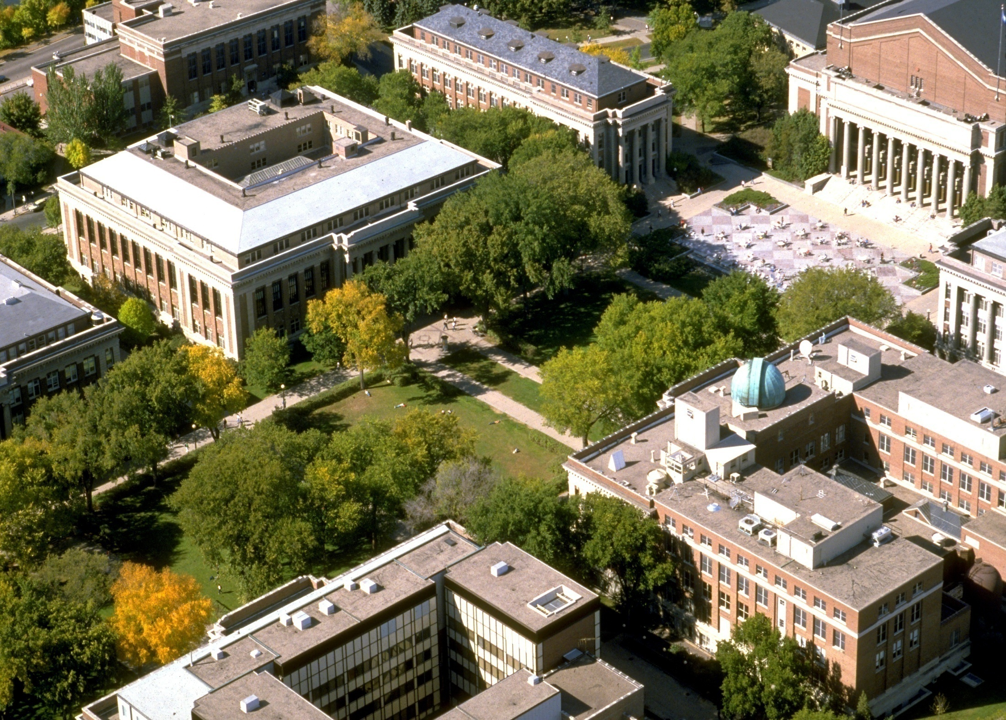

Initiative for Renewable Energy and the Environment (IREE)
…a (brief) history
…the role of the UofMn in Workforce
Development
Richard A. (Dick) Hemmingsen,
Founding Director
MN Renewable Energy Roundtable
October 24, 2013
Senior Fellow,
Department of Bioproducts and Biosystems Engineering
hemmings@umn.edu

Slide 2

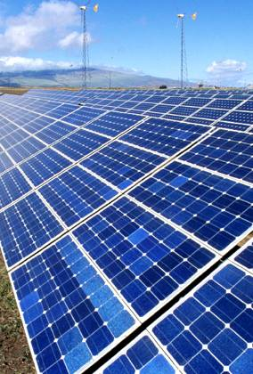
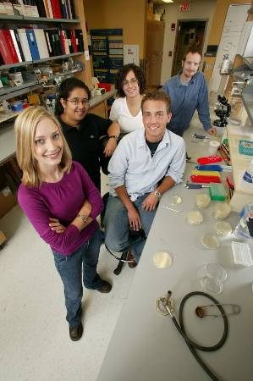
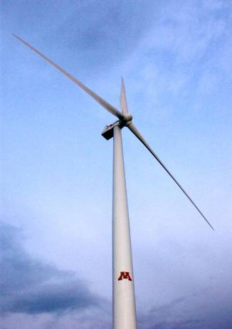


IREE established in 2003 around an important Mission
Innovation to develop
next generation renewable energy systems with…
Economic benefits
Energy security benefits
Environmental benefits

Slide 3
A Systems Approach to Next Generation
energy solutions
Next-generation
feedstocks
Next-generation
conversion systems
Next-generation
Fuels/products
e.g.
DME
Methanol
Green diesel
Butanol
Alkanes
Polymers
Bldg matls
Power
Energy crops
Woody biomass
Prairie systems
Microalgae
Microbes
Waste streams
Biochem
Integrated
Thermochem
Policy, Economics and Ecosystems
(including CO₂ sequestration/GHG reductions)

Slide 4
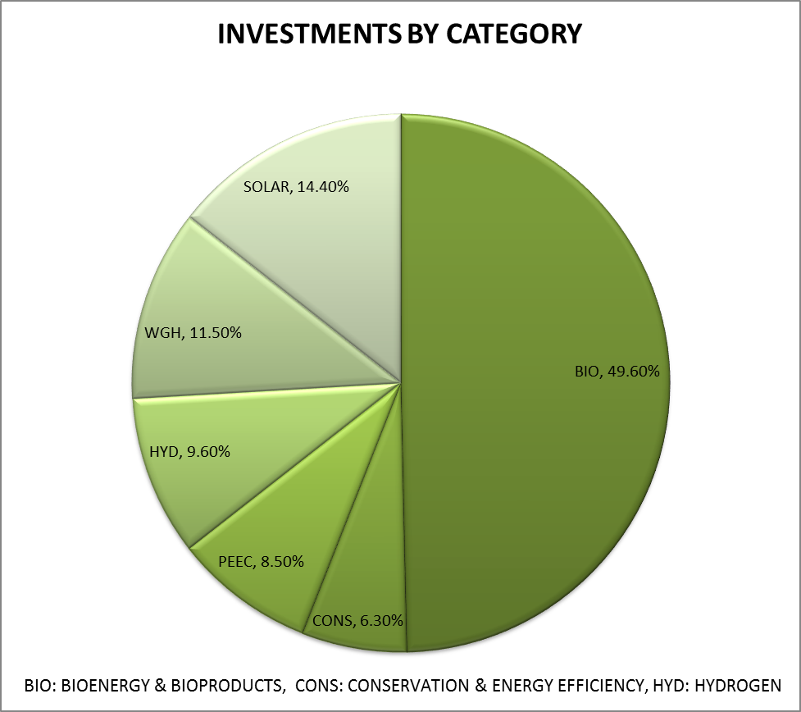

Slide 5
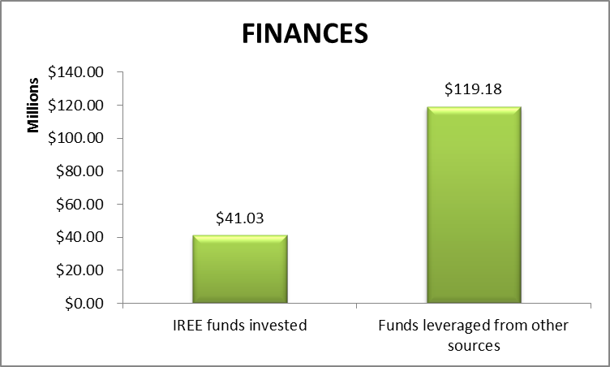

Slide 6
IREE Matching Grant Status (as of Feb. 8, 2012)
1:12 Ratio

Slide 7
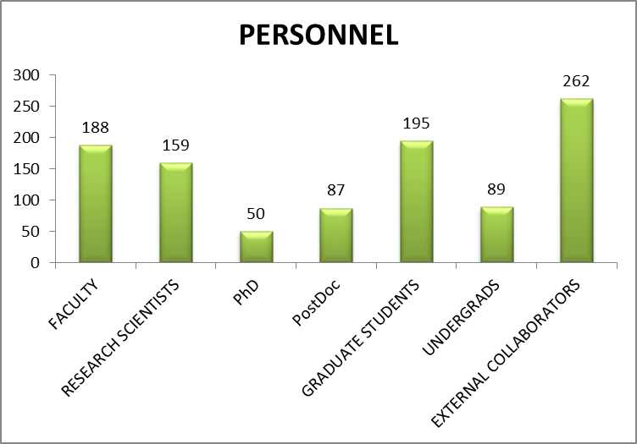
A “Community of Scholars” 800+ Strong

Slide 8
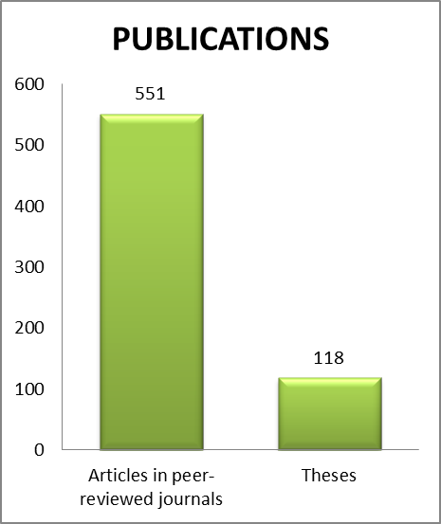

Slide 9

Colleges Connected with IREE
College of Science and Engineering
  Chemical Engineering & Materials Science
  Chemistry
  Civil Engineering
  Computer Science and Engineering
  Earth Sciences
  Electrical and Computer Engineering
  Mechanical Engineering
  St. Anthony Falls Laboratory

Slide 10
Colleges Connected with IREE
College of Food, Agricultural and
Natural Resource Sciences
  Applied Economics
  Bioproducts and Biosystems Engineering
  Fisheries, Wildlife and Conservation Biology
  Forest Resources
  Soil, Water, and Climate
  Water Resources Center
  Animal Science
  Agronomy and Plant Genetics
  Plant Biology

Slide 11
Colleges Connected with IREE
College of Food, Agricultural and
Natural Resource Sciences, cont.
  Cloquet Forestry Center
  North Central Research and Outreach Center
  Southern Research and Outreach Center
  Southwest Research and Outreach Center
  West Central Research and Outreach Center

Slide 12
Colleges Connected with IREE
College of Biological Sciences
  Biochemistry, Molecular Biology and Biophysics
  Biology
  Biotechnology Institute
  Ecology, Evolution, and Behavior
  Genetics, Cell Biology and Development
  Microbiology
  Plant Biology

Slide 13
Colleges Connected with IREE
Humphrey Institute for Public Affairs
College of Design
Carlson School of Management
UofM Crookston
UofM Duluth
Natural Resources Research Institute Institute
UofM Rochester

Slide 14
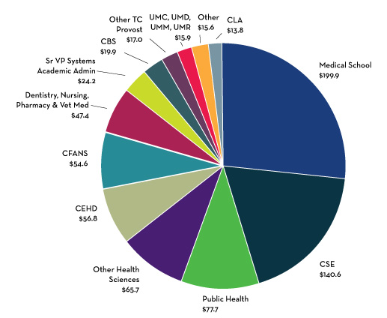
FY 2012 - $749.1 Million in Sponsored Research
*8th among Public Research Universities

Slide 15
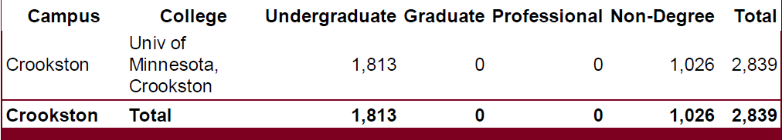
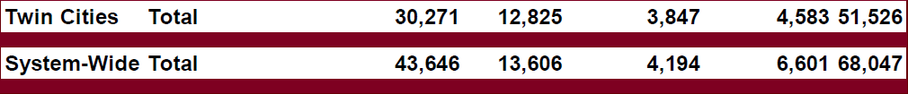
Fall, 2013 University of Minnesota Enrollment
…A significant contributor to workforce development!

Slide 16
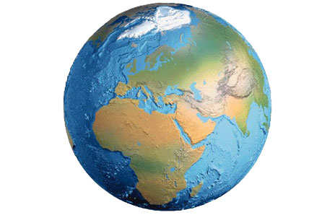
IN SUMMARY…Some parting thoughts
Why Minnesota?
IREE “had it right”
Our Collective Mission
Innovation to develop next-generation renewable energy systems with…
Economic benefits
Energy security benefits
Environmental benefits
Notes:
PRIORITIES AND NEEDS (continued)

Slide 17

I STRONGLY agree with the Presidents’
Position on renewable energy

Slide 18
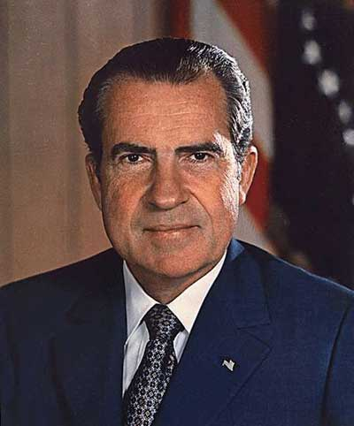
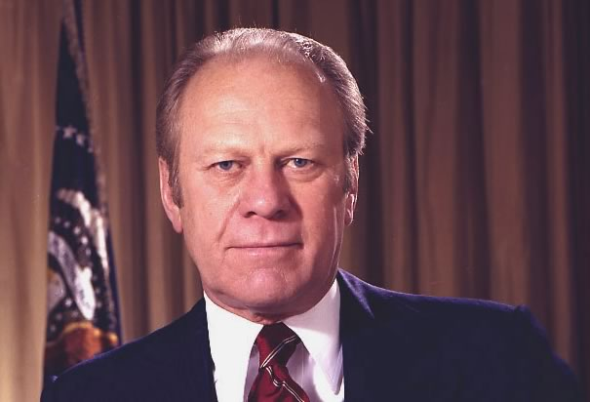
These two……….
We will lay the foundation for our future capacity to meet Americas energy needs from America’s own resources.
We cannot afford delays. We cannot afford prolonged vulnerability to foreign producers. We must act.
-President Richard Nixon, 1974
Image: HistoryKing.com
-President Gerald Ford, 1975
Image: History.com

Slide 19
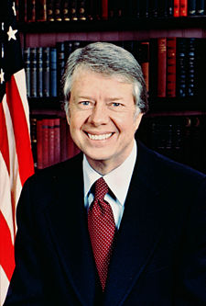

….And these two…..
We are the generation that will win the war on the energy problem and in that process, rebuild the unity and confidence of America.
Energy independence is the best preparation America can make for the future.
Image: wikipedia.com
-President Jimmy Carter, 1979
-President Ronald Reagan, 1982
Image: history.com

Slide 20

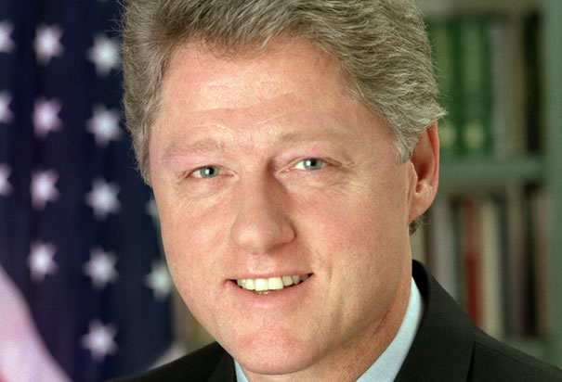
….And these two…..
The Congress should…enact measures to increase domestic energy production and energy conservation – in order to reduce dependence on foreign oil.
We have it in our power to act right here, right now. I propose $6 billion in tax cuts and research and development to encourage innovations, renewable energy, fuel-efficient cars, and energy-efficient homes.
-President George H.W. Bush, 1990
-President Bill Clinton, 1998
Images: history.com

Slide 21
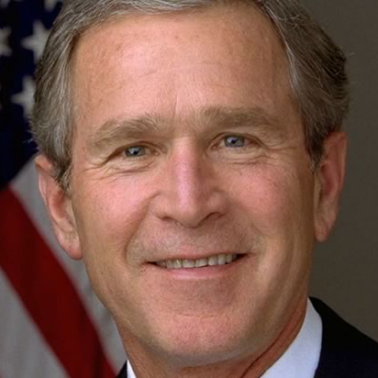
….And this one…..
We have got to do something about our dependence on oil – for two reasons. It provides an economic and national security risk…and…makes it harder to be wise stewards of the environment.
The time for action is now. This is a difficult period for millions of American families. Every extra dollar they have to spend because of high gas prices is one dollar less they can use to put food on the table or send a child to school…
-President George W Bush; 2007, 2008
Image: history.com

Slide 22
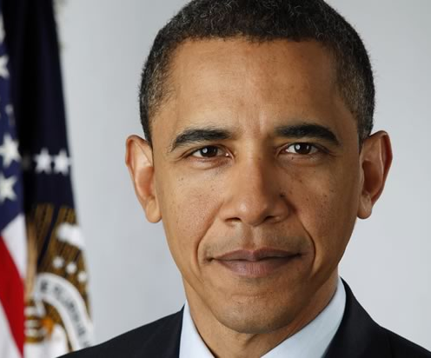
….And this one…..
“That’s why I’ve called for an
investment of $15 billion a year
over 10 years. Our goal should
be, in 10 year’s time, we are free
of dependence on Middle
Eastern oil. And we can do it.”
-President Barack Obama, 2008
"As we recover from this recession, the transition to clean energy has the potential to grow our economy and create millions of jobs - but only if we accelerate that transition. Only if we seize the moment."
-President Barack Obama, 2012
Image: history.com

Slide 23
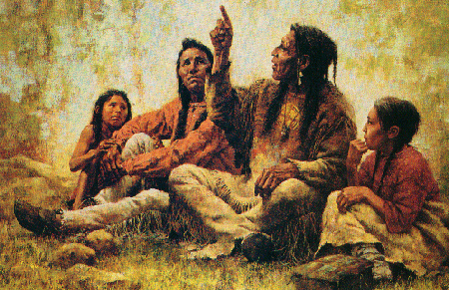

IN CLOSING…
"Treat the earth well: it was
not given to you by your parents,
it was loaned to you by your children.
We do not inherit the Earth from our
Ancestors, we borrow it from our children."
- Ancient Indian Proverb
Notes:
PRIORITIES AND NEEDS (continued)

Slide 24
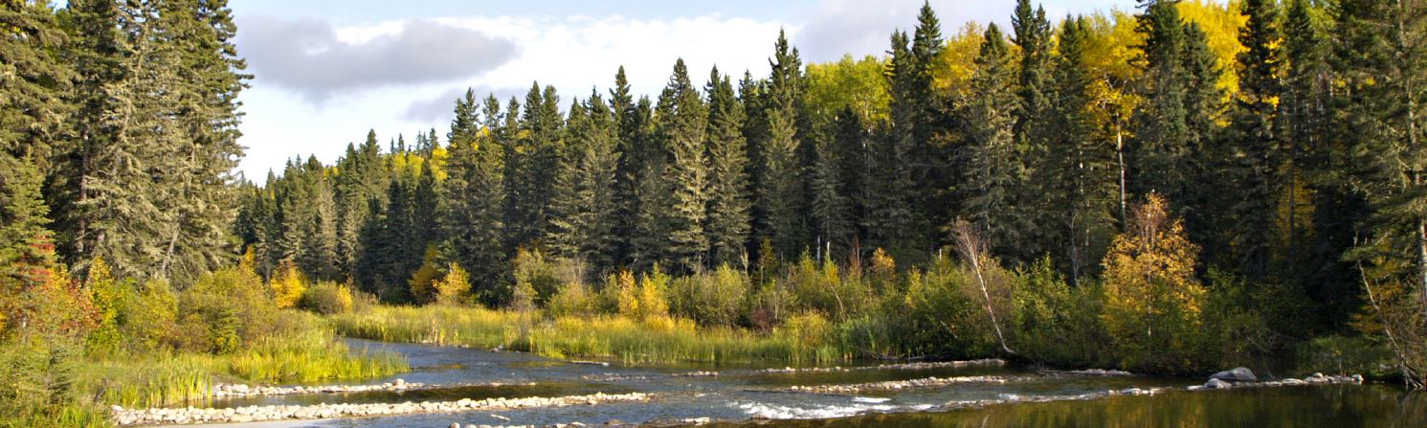

Thank you
Initiative for Renewable Energy & the Environment
iree.environment.umn.edu
Richard “Dick” Hemmingsen, Senior Fellow
612.625.2287
612.386.2339 (Cell)
hemmings@umn.edu

