Slide 1
The Beginning of the Pipeline:
Pre-Employment Academies in Southeast Minnesota
AURI Renewable Energy Roundtable
October 24, 2013

Slide 2
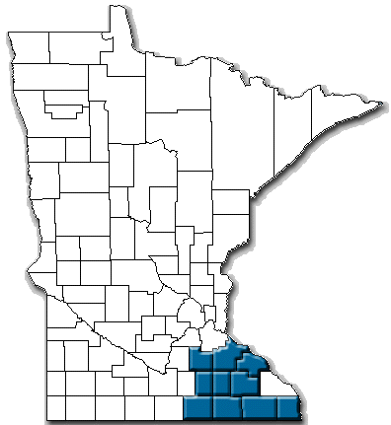
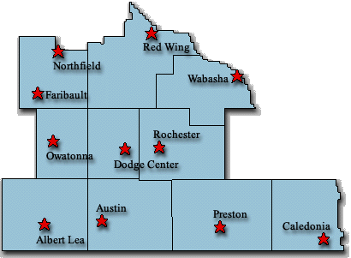
Workforce Development, Inc.
Workforce Investment Board
10 counties in Southeast MN
Staff of about 60

Slide 3
Overview of SE MN Industry Clusters and Segments
2008-2012

Slide 4
Working with a Changing Labor Pool

Slide 5

Master or higher degree positions
1 = FastTRAC Bridge Program
2 = Skill Certification
3 = Integrated courses to higher education
MBA, R&D Robotics engineers
$22.00-$54.00
Bachelor level degree
Engineering; Operation Mgr, depart mgrs, admin, finance computer programmer
19.00-66.00
2 year Technical or AAS training
Industrial maint.; mechatronics, drafting, computer integrated machining,Jobs off production i.e. sales, computers, inspectors, computer system management ;
$15.00-$29.00
3
Diploma/
GED/
English Preparation
On the Job Training or less than 1 year wiith certifications
Forklift driving, welders, machinists, machine operators, company specific equip operators
2
$12.00-$26.00
Short-term training w/ Certification
Production welders, first line supervisors, machinists, operators, careers outside manuf.
Other industries requiring welding skills: “Job Shop” fabricator, auto body, agriculture mechanics, emerging green jobs,
$12.00-$22.00
1
ENTRY:
Expressed interest or experience
Low Skill entry level jobs that are physical or monotonous (Production workers, assembly workers)
$8.00-$16.00

Slide 6
A Sector Solution to a Key Problem
The Problem:
  High turnover rates (must have everyone contribute)
  High drop-out rate in college entry-level classes (stops education)
  Misunderstanding of the job by potential workers (increases training time and turnover)
  Safety concerns in the workplace
  Availability of diverse workers

Slide 7
The Solution:
Pre-employment Academies
Work with businesses to fill vacancies and reduce their turnover.
Integrate classes into business sites to ensure academies are driven by current business needs and trends
Students are mentored and supported by professionals to reduce turnover.
Targeted to entry level positions while emphasizing career laddering
Enhance the academic skills and support in preparation to enter professional training programs.
Increase the opportunities for diversity.

Slide 8
Pre-employment Academies
4 week training - understand the nature of the work and career opportunities
College credential classes scheduled immediately after Academy classes end
Insure access to credential classes at community college

Slide 9
Critical Success Factors of Pre-employment Academies
Industry-Driven:
  Curriculum development and updating
  Employment preference for graduates
  Dialog with job counselors on retention issues
  Tours, speakers, use of facilities and equipment for classes
Convener Coordinates:
  Convenes the advisory meetings
  Recruits and screens appropriate students
  Works with employers and students as they transition into employment
  Address retention issues
  Must be able to “speak the language” of business

Slide 10
Critical Success Factors of Pre-employment Academies
Involves Many Partners:
  Businesses
  Community College
  Workforce Centers
  Adult Basic Education
  Media
Meets Needs of Employers, Schools and Workers:
  Employers get workers who understand their roles
  Workers get access to good paying, rewarding jobs with a future.
  Limited training slots not wasted.

Slide 11
Sustainability Strategies
Secure On-going Funding:
  Grants and program dollars from several sources
  Discussions and agreements for employer payments
  Coordination with Adult Basic Education
  Difficulty in working with students before they become employees is overcome through relationships
Engage Employers:
  Careful referrals build trust
  Open and frequent communication
  Advisory panels, tours, speakers, employee release time for presentations to class, agreement to pay for training, shared success
  Able to “speak the language” of business

Slide 12
Sustainability Strategies
Promote Systems Change:
  College class reservations and additional classes scheduled for us
  Discussions with influencers within the systems
Show Results
  Return on Investment
  Cost per Placement

Slide 13
The BIG Question:
DOES IT WORK?

Slide 14
Return on Investment

Slide 15
Pre-employment Academies
Healthcare
Manufacturing
Renewable Energy
Customer Service

Slide 16
Contact Information:
Becky Thofson
Sector Projects Coordinator
Website: www.workforcedevelopment.ws
Email: bthofson@wfdi.ws
Phone: (507) 259-5209 (cell)

